Slide 1
CHM 102A
Course Description:
Physical Chemistry: Quantum Theory, Quantum Mechanics of simple systems: Particle in a Box, Harmonic Oscillator and Rigid Rotor. Hydrogen Atom, Many-Electron Atoms, Molecular Orbital Theory, Spectroscopy of Simple Molecules.
Inorganic Chemistry: Crystal Field Theory and Structure of Coordination Complexes, Oxidative Addition, Reductive Elimination, Insertion Reactions, Hydrogenation, Hydroformylation, Monsanto Acetic Acid Process and Ziegler-Natta Polymerization, Metalloenzymes
Organic Chemistry: Conformational Analysis of Alkanes and Cycloalkanes, Chirality, Substitution and Elimination Reactions, Introduction to Biomolecules.
Online page: https://piazza.com/iitk.ac.in/secondsemester2018/chm102a/home

Slide 2
CHM 102A
Tutorial Details
Tutorials: (Physical Chemistry; Organic/Inorganic)
 | Days | Time | Venue
Section A F 9-10 am | January 5, 12, 19 February 2, 3*, 9, 16 March 9, 10*, 16, 23 April 6, 13, 20 | 9-10 am | L11, L12, L13, L14
Section B T 4-5 pm | January 9, 16, 23, 30 February 6, 13 March 6, 13, 20, 27 April 3, 10, 17 | 4-5 pm | L3, L4, L5, L6
LHC Room | Tutorial Section | Physical Chemistry |  | Inorganic/Organic Chemistry
L11 | A1 | Aritra Das* | M. Chandra | B. Sundararaju | J. N. Moorthy
L12 | A2 | T. G. Gopakumar | Bidhan Hazra* | J. K. Bera | D. H. Dethe
L13 | A3 | N. Nair | Sourav Karmarkar* | R. Angamuthu | R. Gurunath
L14 | A4 | S. Manogaran | Ajitesh Singh* | A. K. Patra | R. Ramapanicker
L3 | B1 | Subhamoy Char* | M. Ranganathan | G. Anantharaman | V. K. Yadav
L4 | B2 | D.L.V.K. Prasad | Kumari Sonia* | S. K. Kundu | Y. D. Vankar
L5 | B3 | K. Srihari | Bansi Das* | P. K. Bharadwaj | M. L. N. Rao
L6 | B4 | P. Sen | Manendra Singh Chauhan* | S. P. Rath | M. K. Ghorai

Slide 3
CHM 102A
Books:
Inorganic Chemistry: Shriver and Atkins
Inorganic Chemistry: C. L. Housecroft & A. G. Sharpe
Inorganic Chemistry: Principles of Structure and Reactivity
J. E. Huheey, E. A. Keiterand R. L. Keiter
Organic Chemistry by J. Clayden, N. Greeves, S. Warren
Fundamentals of Organic Chemistry by T. W. G. Solomons
Organic Chemistry by R. T. Morrison, R. N. Boyd

Slide 4
Chemistry Milestones and Impact on Society
(Selected Examples)
Evolution of Chemistry as a Window
to the Scientific Process

Slide 5
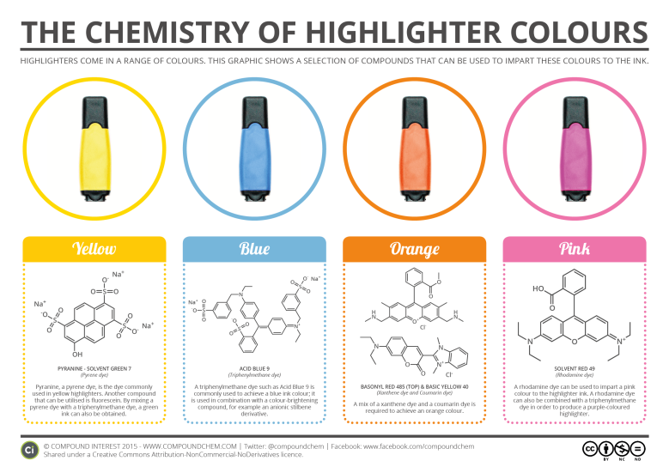
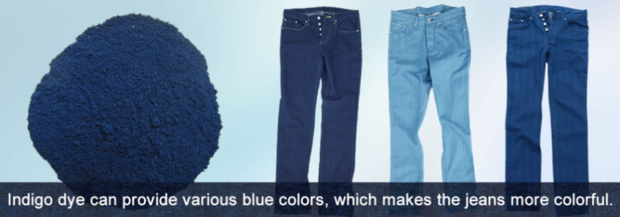
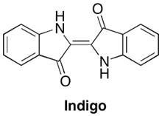
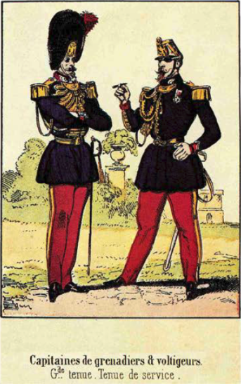
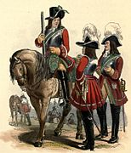
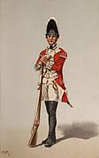
Chemistry Brought Color to Humanity
Global consumption of dyestuffs: 2.5 million tons
Fields of application: Textiles, food, paints, coloured polymers…
Use of colour is not always for fashion
French Army Uniform
During war with Germany
in 1870
17th century Britain
18th century Britain

Slide 6
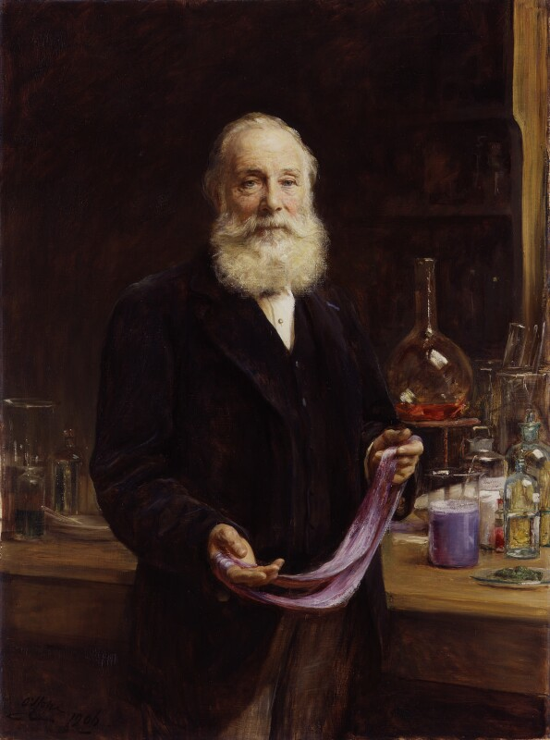
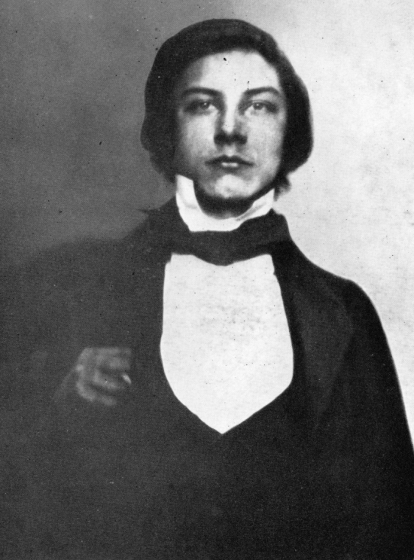
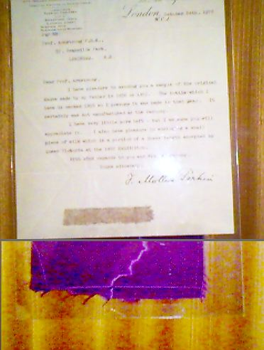
Establishment of Synthetic Dye Industry
Sir William Henry Perkin
W. H. Perkin at age 14
Mauevine (also known as Mauve or purple) was the first commercial synthetic dye
Invented serendipitously by Perkin in 1856 when he was 19 years old

Slide 7
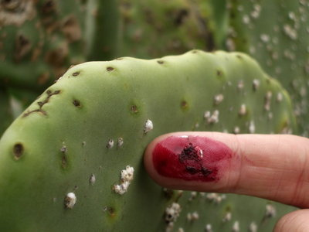
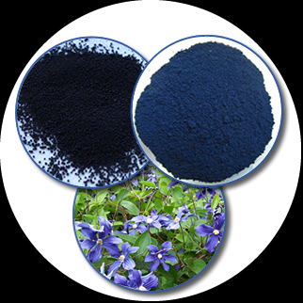
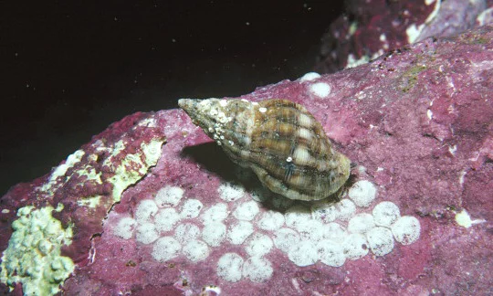
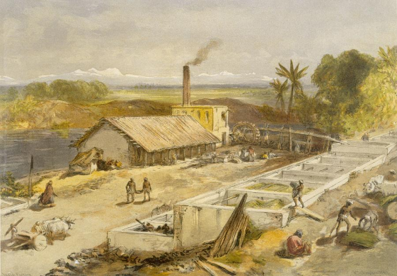
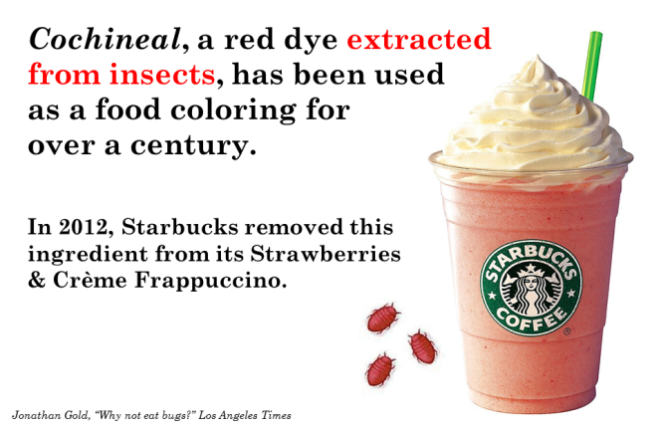
How Were Colors Obtained Before Perkin?
Colors were few and far between
All colors were derived from natural products (plants, insects)
Very expensive and labour intensive to produce
Not fast to washing and faded in sunlight
Cochineal bugs give red color when crushed
Indigo was obtained from plant
Murex (sea snails) provided purple
1,00,000 bugs required for 1 kg of dye
Only royalty and rich people could
afford purple
Indigo production in West Bengal 1890

Slide 8
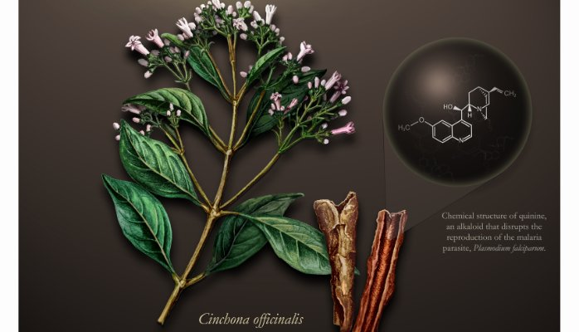
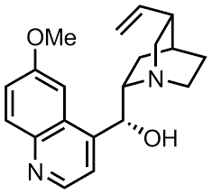
Perkin’s Original Goal
Quinine
Quinine was being used for its anti-malarial activity
Difficult to obtain in large amounts from the bark of the Cinchona tree
On the suggestion of his research supervisor, Perkin tried to make Quinine in the lab

Slide 9

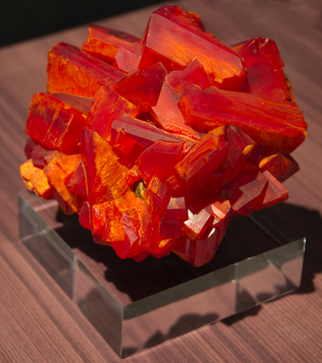
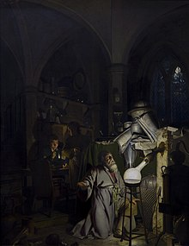
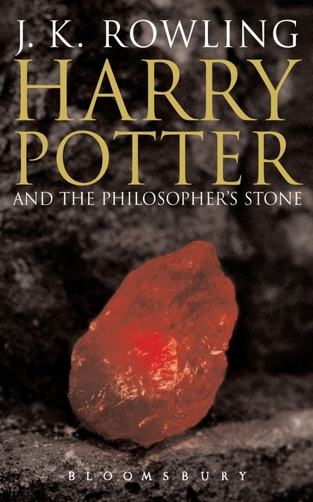
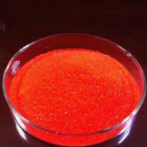
Perkin’s Hypothesis
At that time, structure of quinine was unknown
Quinine
In 1856,
Understanding of chemical bonding was non-existent
Structure of benzene was not known!
The molecular formula of Quinine was known: C₂₀H₂₄N₂O₂
K₂Cr₂O₇
“philosophers stone”
supposedly could convert
other metals to gold
Univ. of Edinburgh
“philosophers stone!”

Slide 10
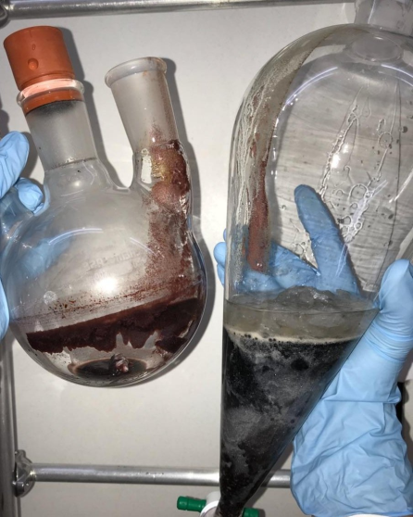
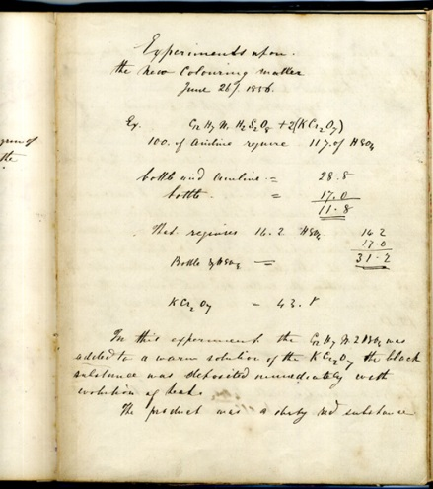
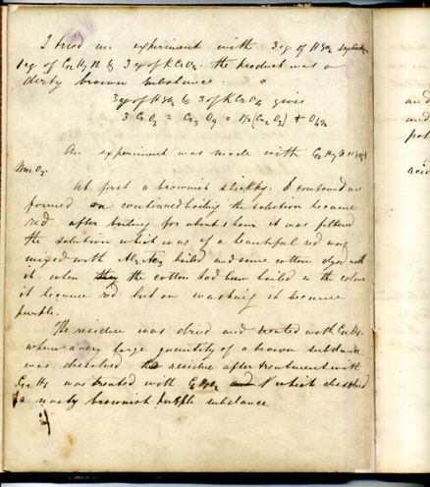
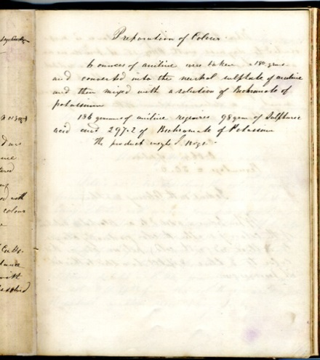
Perkin’s Hypothesis
Quinine
Outcome of the experiment
C₁₀H₁₃N
While washing the flask, Perkin noticed that a purple solution resulted
Note the purple fingerprints!

Slide 11
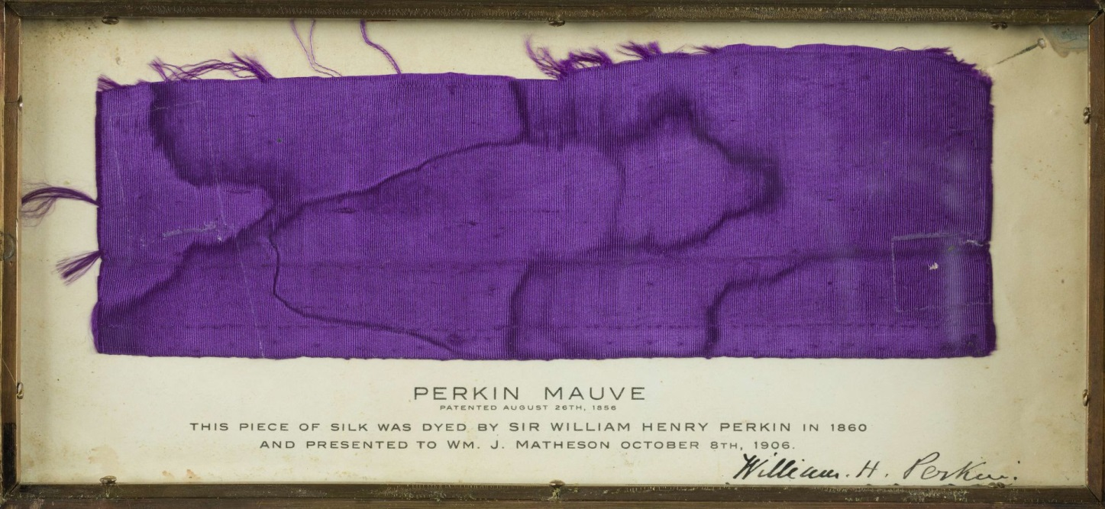
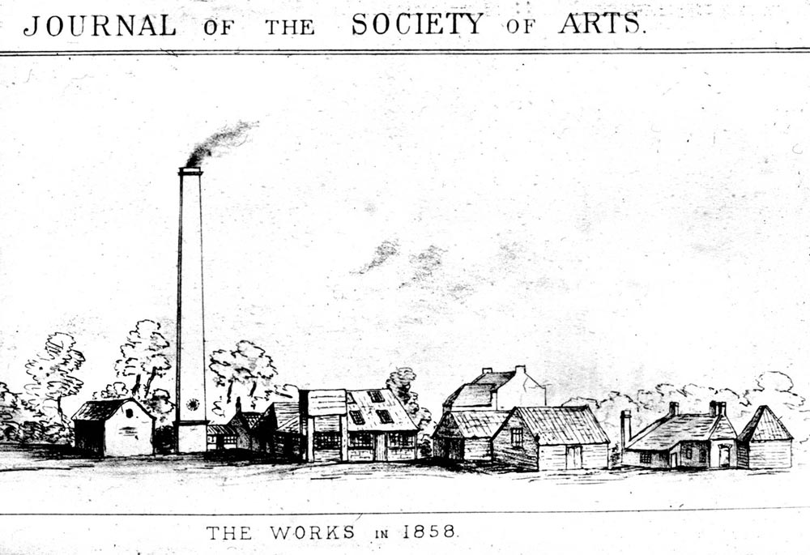
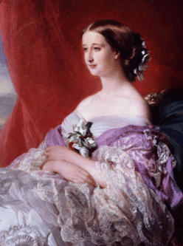
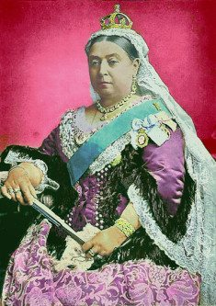
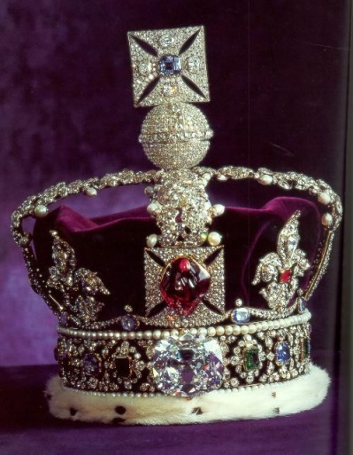
Discovery Consists of Seeing What Everybody Has Seen, Thinking What Nobody Has Thought
Color does not fade in light
Easy to make and apply
National Museum of American History,
Smithsonian Institution
Perkin and Sons Factory
Eugenie (Empress, France)
Victoria (Queen, England)
Imperial State Crown, Britain

Slide 12
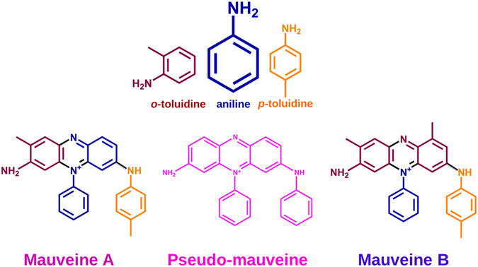
Chemical Structure of Perkin’s Muave
Perkin realized that his original starting material contained impurity of aniline
However, using pure aniline resulted in an inferior dye
The constituents of Perkin’s Mauve were characterized in 1994.
J. Chem. Soc., Perkin Trans., 1994, 1, 5–7, 1994

Slide 13
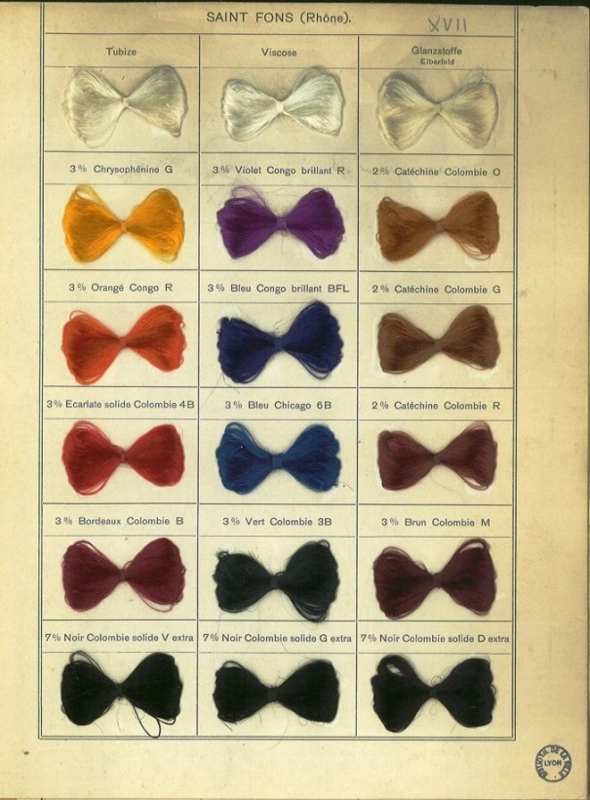
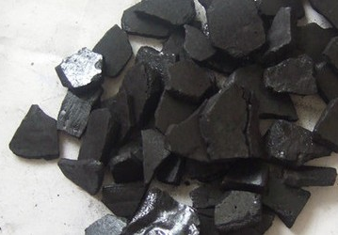
Perkin’s Legacy
Established chemistry as an alternative to nature for obtaining functional compounds
Demonstrated that chemistry can lead to profitable enterprise
Revolutionized the way people thought about “Multistep Chemical
Synthesis”
Coal tar
Valuable chemicals

Slide 14
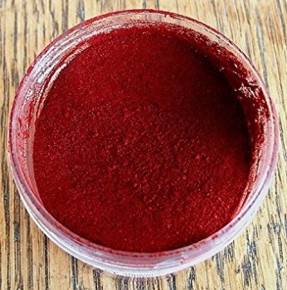
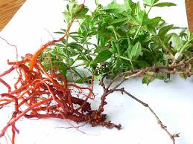
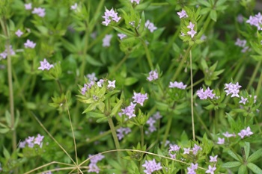
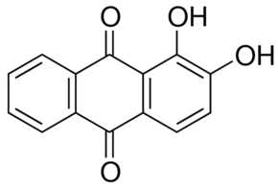
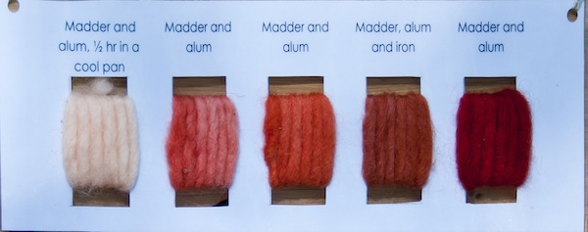
Perkin’s Legacy
In 1868, anthracene (obtained from coal tar) was shown to be
the precursor for the dye Alizarin
anthracene
Alizarin Dye
Madder plant with root
Madder plant

Slide 15


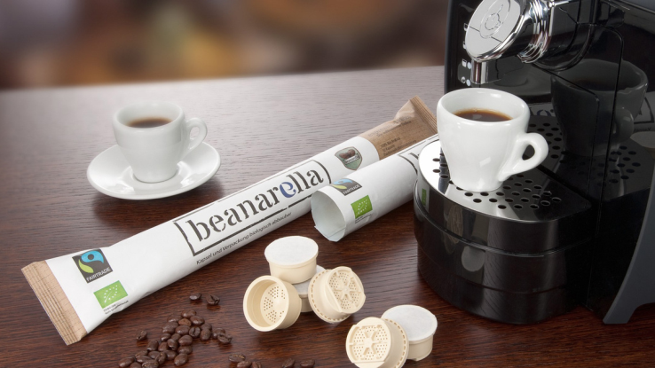
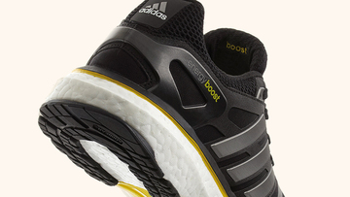
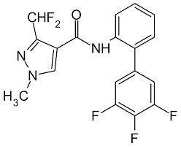
Perkin’s Legacy: Emergence of German Dye Industry
The company BASF was founded in 1865 to make aniline based dyes
BASF stands for Baden Aniline and Soda Factory
BASF patented their synthesis of Alizarin one day before Perkin
Alizarin
Largest chemical company in the world
Annual revenue of 47 billion euros in 2015
Developed “Humira”: Medicine for Rheumatoid Arthritis
compostable polymers
Lightweight, strong materials
fungicides

Slide 16
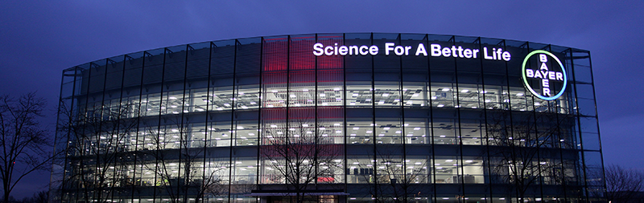
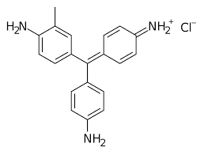
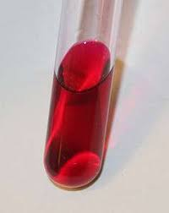
Emergence of German Dye Industry
The company Bayer was founded in 1863 to make aniline based dyes
Annual revenue of 47 billion euros in 2015
Bayer’s initial dye
Bayer was multinational in 1901!
(Boxes of dyes)
Rosaniline hydrochloride
1901: Bayer’s supply depot in Ahmedabad

Slide 17
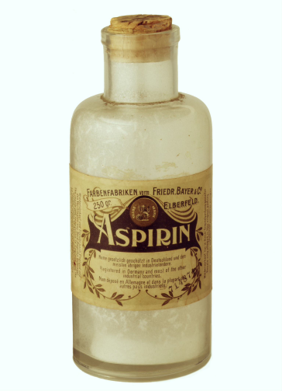
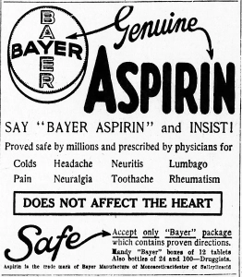
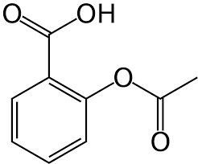
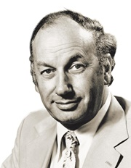
1897: Bayer Produces Aspirin
1897: German chemist Felix Hoffmann, finds that adding an acetyl group to
salicylic acid reduces its irritant properties and Bayer patents the process
Acetylsalicylic Acid (Aspirin)
[antipyretic (fever reducing); analgesic (pain reducing)]
1950: Aspirin enters the Guinness World Records for being the most frequently
sold painkiller.
1971: John Vane, professor of pharmacology at the University of London,
publishes research describing aspirin’s mechanism of action. He later wins a
Nobel prize (1982) for this work, along with Bengt Samuelsson and
Sune Bergström.

Slide 18
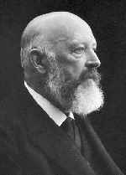

What Happened to Perkin?
At the age of 35, Perkin “retired” from industry. He sold his company and went
to his lab to pursue new chemistry.
He discovered the “Perkin Reaction”.
In 1897, Adolf von Baeyer used this reaction to
synthesize Indigo (sold by BASF). Baeyer won
Nobel Prize in 1905 for his work on dyes.
In 1897, 19,000 tons of plant sourced indigo was being made. After
the laboratory synthesis, this share dropped to 1000 tons.
Adolf von Baeyer
Current annual production is about 5000 tons, almost all of it for the dyeing of
jeans. For every pair of jeans, 10 g of indigo is required.

Slide 19
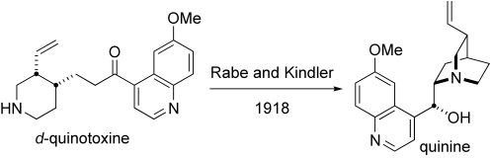
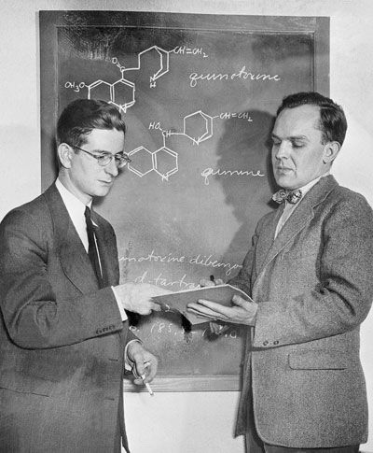

What Happened to Quinine?
Research into the structure and synthesis of quinine
Quinine
R. B. Woodward and W. E. Doering
1947: Bayer develops chloroquine for treating malaria.
Chloroquine

Slide 20









Synthesis: From Chance to Strategy
R. B. Woodward demonstrated the power of organic synthesis
Quinine; 1944
Cortisone; 1951
Cholesterol; 1951
Strychnine; 1954
chlorophyll; 1960
Lanosterol ; 1954
Reserpine; 1956
tetracycline; 1962
1965 Nobel prize for “Outstanding Achievements in the Art Of Organic Synthesis”
Vitamin B12; 1981

Slide 21






William Perkin: A Pioneer and Trailblazer
Knowledge, Drive, Astute Observational Skills and Risk Taking
W. H. Perkin: Conducted experiments at
his home
Hewlett and Packard
Garage where HP company
was started; Palo Alto, California
Paul Allen and Bill Gates
Steve Jobs in front of his parents’ garage
Google’s initial days in a garage

Slide 22



Chemistry in Electronic Devices
Gorilla Glass: A chemically strengthened glass
Ion exchange
(Sodium with potassium)
1000 ° C
Corning developed toughened glass in 1960’s for a few industrial applications
Automotive industry rejected gorilla glass because of higher cost;
Corning termed the project a failure
Gorilla glass now features in over 2.5 billion devices

Slide 23




Chemistry for Displays (OLEDs)
An OLED is an electronic device made by placing a series of
organic thin films between two conductors. When electrical current is applied, a bright light is emitted.
A device that is 100 to 500 nanometers thick or about 200 times smaller
than a human hair.

Slide 24


Chemistry in Computing
Nobel Prize awarded to three researchers for their work on semiconductors and their discovery of the transistor effect.
First transistor; Bell Labs 1947
The first transistor was made from Germanium (a semi conductor).
Then why do we have a “Silicon Valley” but not “Germanium Valley”?
Chemistry is involved in every iteration of miniaturization.

Slide 25


Chemistry in Computing: Storage
Magnetic materials are used to store data because it
should not be lost in the “off” mode
Re-writable CD’s use phase-changing alloys

Slide 26


Chemistry in Computing: The Future
The first “Chemical Hard Drive”: stores data in oscillating three chemical droplets kept in contact with each other
The very basic unit (3 droplets) can store one byte of data and is called “chit” (for chemical bit)
The concept is based on the Belousov-Zhabotinsky (BZ) reaction, which an oscillatory reaction.
Phys. Chem. Chem. Phys., 2017, 19, 6519

Slide 27









Early Landmarks in Chemistry
John Dalton
Atomic theory
Jon Jacob Berzelius
Atomic weight, electrochemistry
(wrote the 1st chemistry textbook)
Friedrich Wohler
Synthesis of urea
August Kekule
Theory of chemical structure
Structure of benzene
Dmitri Mendeleev
Periodic table
Jacobus Van’t Hoff
Tetrahedral carbon, kinetics,
First Chemistry Nobel Laureate
Emil Fisher
Organic Chemistry
Chemistry Nobel Laureate
Svante Arrhenius
Physical Chemistry
Chemistry Nobel Laureate
Alfred Werner
Structure of inorganic compounds
Chemistry Nobel Laureate

Slide 28


More Pioneers in Chemistry
= Nobel Prize
www.compoundchem.com

Slide 29




From Dreaming Atoms to Seeing Atoms
1865
2009
2012
Atomic Force Microscopy: pentacene molecule

Slide 30

Chemistry for Understanding Biology
Chemistry of Vision
Vitamin A is the precursor of all-trans-retinal, the pigment portion of rhodopsin.
Lack of vitamin A causes a decrease in retinal.
This results in a decreased production of rhodopsin and a lower sensitivity of the retina to light or night blindness.

Slide 31

Chemistry for Understanding Biology
https://cen.acs.org/articles/95/i10/Periodic-graphics-anti-aging-creams.html

